Slide 1
Website Development
DEMO 2
Josh Naraine, Jalen Maspono, Kevin Clark, Bryan Vuong
Notes:
Jalen

Slide 2




(Front-End) IDE/Languages
VSCode IDE
JavaScript
HTML
CSS
Notes:
Josh

Slide 3



Back-End (SQL & PHP)
Vscode IDE
PHP
SQL
Xampp
Notes:
Brayn

Slide 4
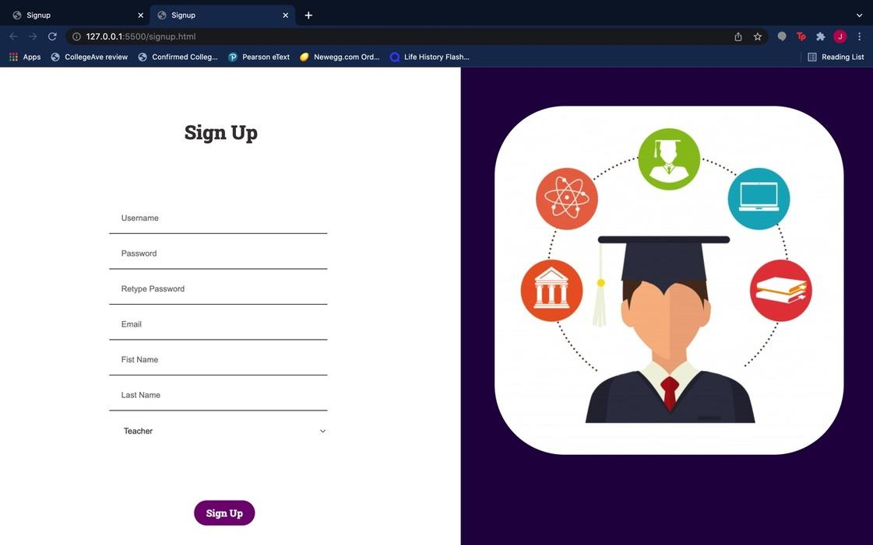
(Front End) Member’s contribution
Sign Up Page
Initiating Actor: Teacher, Student
Participating Actor: Database
Allows both the Student and Teacher to create a profile in order to gain access to their account.
Email input only accepts .edu emails
Notes:
Jalen

Slide 5
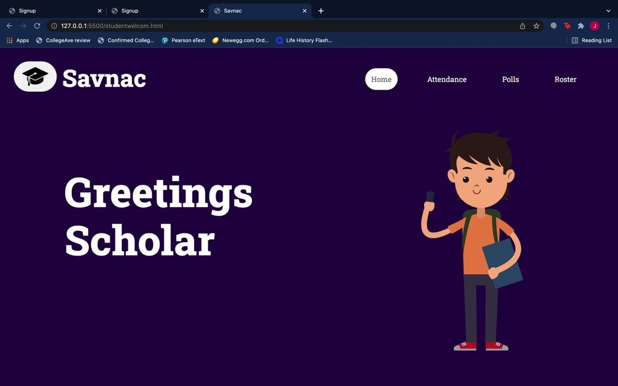
(Front End) Member’s contribution
Student Dashboard Page
Initiating Actor: Student
Participating Actor: Database
Allows students to browse through their account and view their dashboards.
Readable
User-Friendly
Notes:
jalen

Slide 6
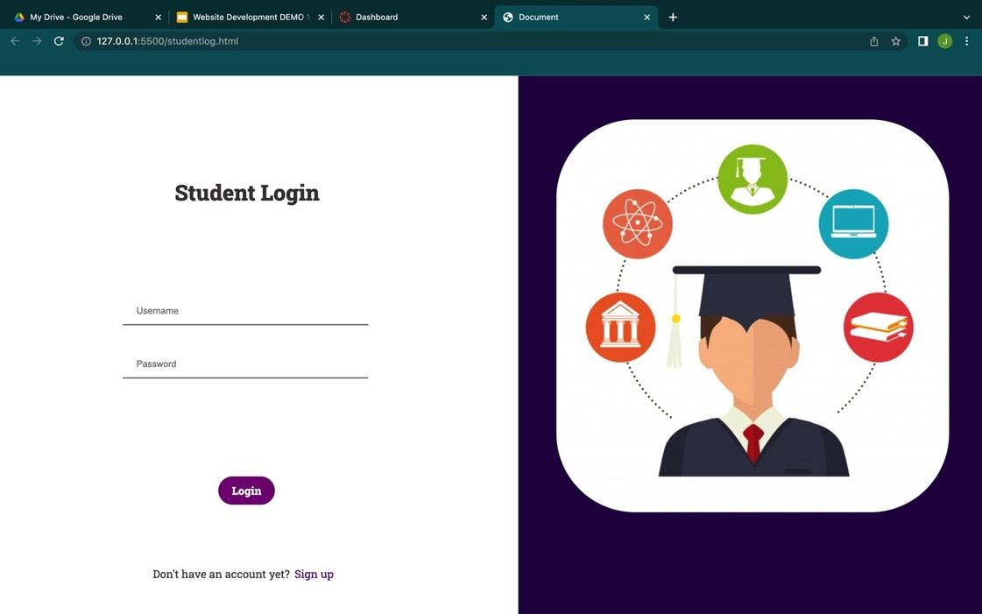
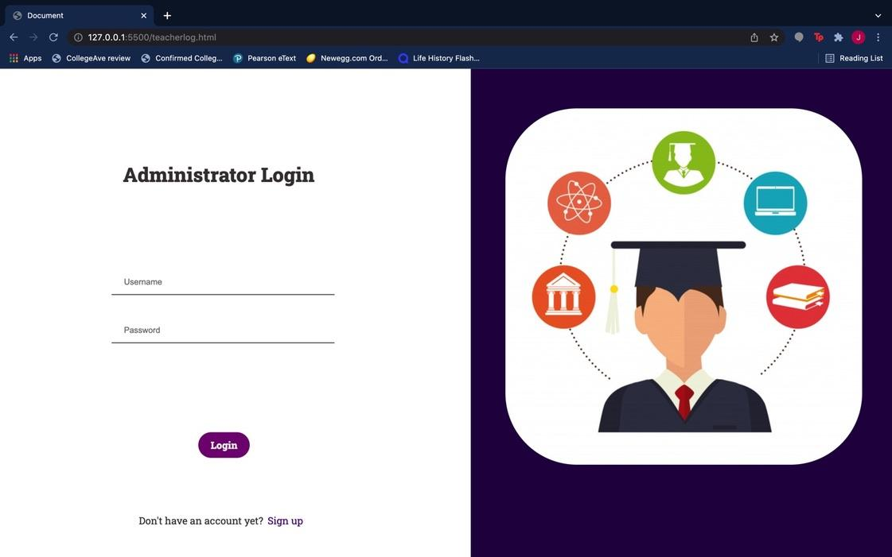
(Front End) Member’s contribution (cont…)
Login Page
Initiating Actor: Teacher, Student
Participating Actor: Database
Allows both the Student and Teacher to create a profile in order to gain access to their account.
Notes:
Jalen

Slide 7
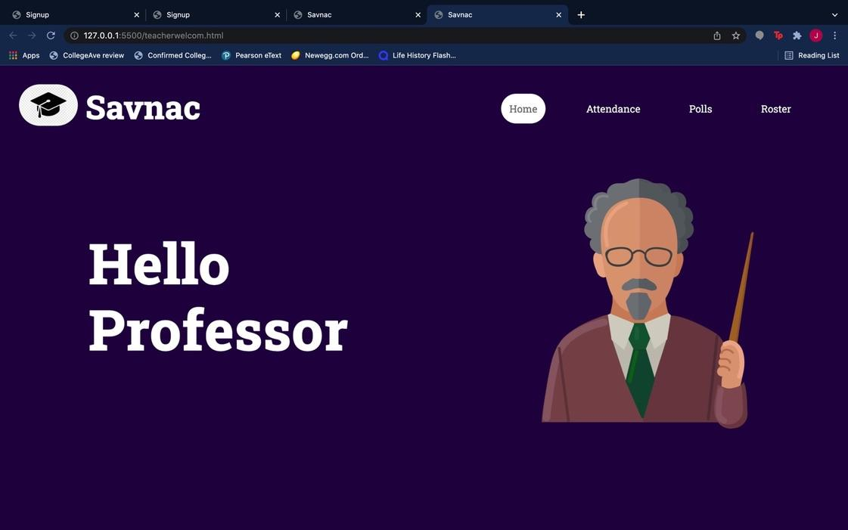
(Front End) Member’s contribution (cont…)
Instructor/Professor Dashboard Page
Initiating Actor: Instructor
Participating Actor: Database
Allows Instructors to browse through their account and view their dashboards.
Readable
User-Friendly
Notes:
Josh

Slide 8
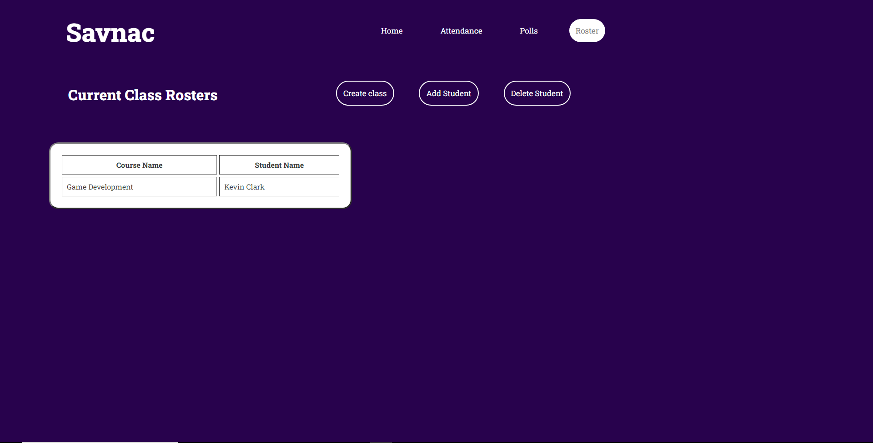
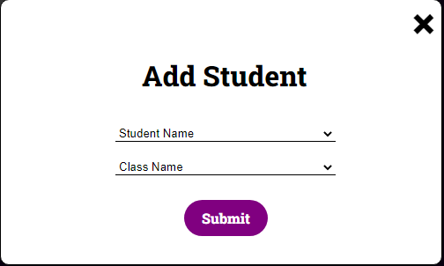
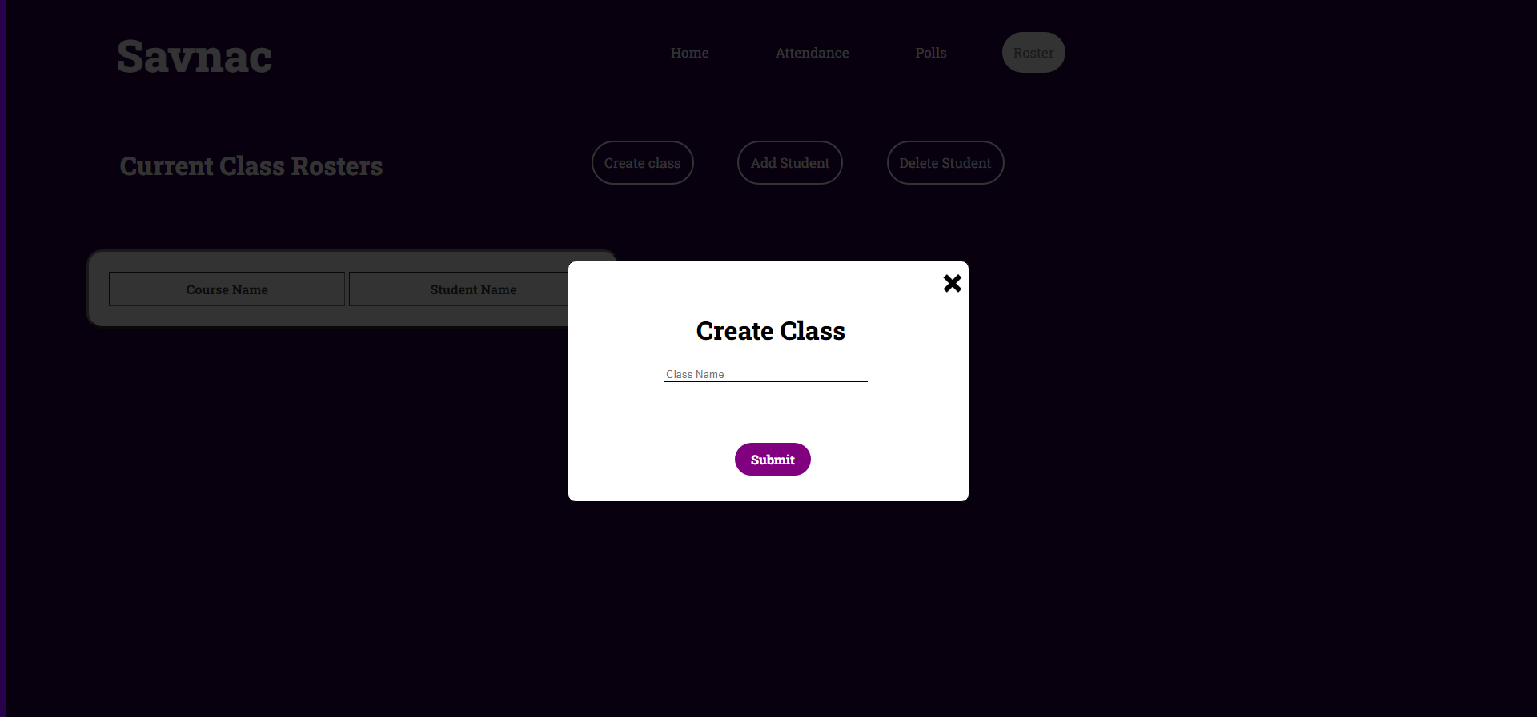
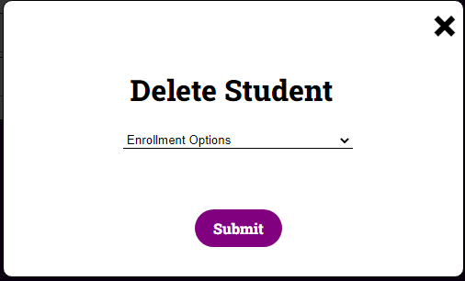
Front End (Continuation)
Course Creation Roster
Initiating Actor: Teacher
Participating Actor: Database, Student
Allows the teacher to create a course
Provides an Add/Delete button
Notes:
Josh

Slide 9
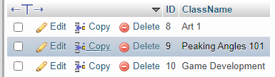
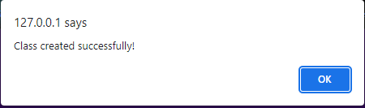
(Back End) Contribution
Create Class
Initiating Actor: Instructor
Participating Actor: Database
Instructor enters a name of a class to be inserted into the database
Notes:
Bryan

Slide 10
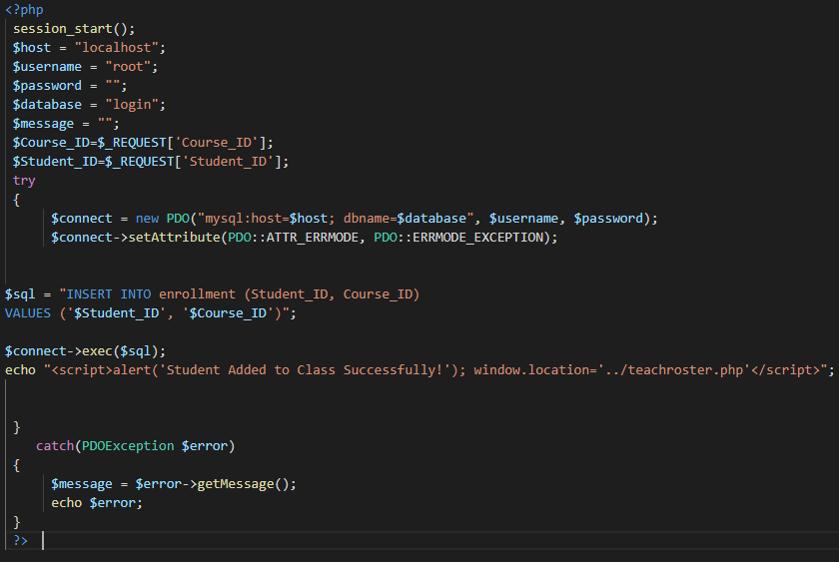
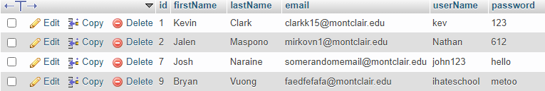
(Back End) Contribution
Add student
Initiating Actor: Instructor
Participating Actor: Database
Instructor enters a name of a student to be added into a existed class
Notes:
Bryan

Slide 11
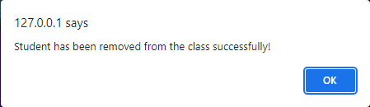
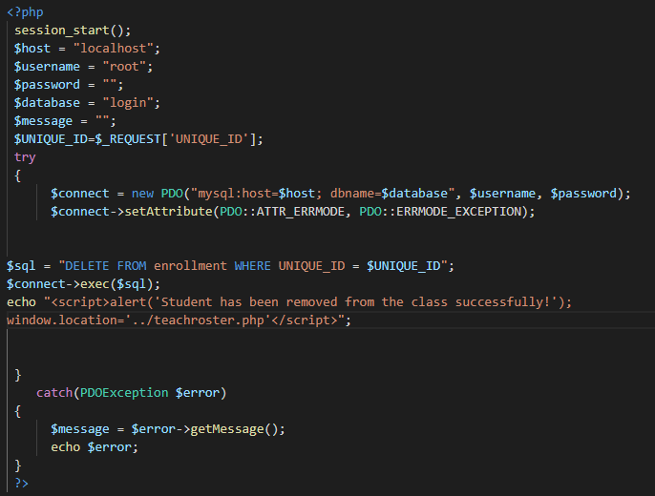
(Back End)
Delete Student
Initiating Actor: Instructor
Participating Actor: Database
Instructor will delete a student from a class that was given to them
Notes:
Kevin

Slide 12
Challenges
A main challenge that we have faced was based off of the backend of the course creation. Encountered many errors such as
Duplication error 1062 (Add Student was returning default values and not the actual values)
Primary ID being returned instead of Name
Table breaking randomly at some point
Multiple Syntax errors
Due to Time Constraints the enrollment table is only ordered by ascending ID by classes
Notes:
Kevin

